Slide 1

Vel Tech Rangarajan Dr. Sagunthala R&D Institute of Science and Technology
School of Computing
Department of Computer Science and Engineering
10211CS224 / FULL STACK APPLICATION DEVELOPMENT (JAVA)
END SEMESTER PROJECT REVIEW
Date: 06-05-2026
PROJECT TITLE
“Ticket Booking System for Internal Department Events ”
SDG: SDG No – SDG 4 – Quality Education
Presented By:
K. Sumanth Reddy – VTU26845– 23UECS0253
Courses Handling Faculty:
Dr. HAFIZUR RAHMAN - B.E., M.Tech., Ph.D. ASSISTANT PROFESSOR

Slide 2

INTRODUCTION
Background of the Problem:
Traditional event ticket booking methods are often manual or semi-digital, leading to issues like long queues, data mismanagement, double bookings, and lack of transparency. Paper-based systems are time-consuming and inefficient, especially when handling multiple events and large numbers of participants.
Why this Project is Important:
This project provides a digital solution to simplify and automate the ticket booking process. It reduces manual effort, minimizes errors, ensures better data management, and offers a user-friendly interface for both organizers and participants. It also promotes a paperless environment.
Real-World Relevance:
Online ticket booking systems are widely used in real life for events like college fests, seminars, concerts, and workshops. This system reflects real-world applications by enabling users to book tickets anytime and anywhere, making event management more efficient and scalable.
Brief Overview of the System:
The Event Ticket Booking System is a React.js-based web application that allows users to view events, select date and time, book tickets, and receive confirmation with QR codes. The system manages bookings, stores user and event data and provides features like booking history and ticket management through an interactive user interface.
1
2
3
4
5
6
7
8
9

Slide 3
PROBLEM STATEMENT
Time-consuming: Manual event registration and ticket booking consume significant time and effort for both users and organizers.
Limited accessibility: Users may not have a centralized platform to view all upcoming department events .
Poor event management: Difficulty in tracking registrations, seat availability, and participant details efficiently.
Data loss risk: Manual or unstructured systems may lead to loss of participant and booking information.
Security concerns: User data and booking details may not be handled securely in traditional systems.
No real-time updates: Users cannot get instant updates on ticket availability or event status.
Need: A secure and responsive web application to manage event listings, ticket booking, and user data efficiently using modern technologies like React.js.
1
2
3
4
5
6
7
8
9

Slide 4
OBJECTIVE(S)
Design & develop: To build a responsive React.js-based web application that enables users to easily browse, book, and manage tickets for internal department events (target: reduce manual registration effort by ≥50%).
Implement & evaluate: To provide real-time event updates, secure user authentication, efficient ticket management, seat availability tracking, and persistent data storage for seamless user experience across sessions.
1
2
3
4
5
6
7
8
9

Slide 5
PROPOSED SYSTEM
Overview: Lightweight web application that enables users to browse, book, and manage tickets for internal department events with real-time updates and secure access.
Automation: Automated event listing, ticket booking, and seat allocation reduce manual registration effort and improve event management efficiency.
Real-Time Updates: Instant updates on event availability, booking status, and seat capacity help users make quick decisions.
Secure Access: User authentication and session management ensure that only authorized users can access booking details and personal information.
Data Persistence: Event and booking data are securely stored in databases, ensuring consistency across sessions and devices.
Collaboration: Enables organizers and participants to interact efficiently, with admins managing events and users accessing bookings seamlessly.
Event Analytics: Dashboard for organizers to track registrations, monitor attendance, and analyze event participation trends.
Advantages over current systems: Faster booking process, reduced manual work, real-time updates, secure data handling, improved event management, and a responsive web-based solution.
1
2
3
4
5
6
7
8
9

Slide 6
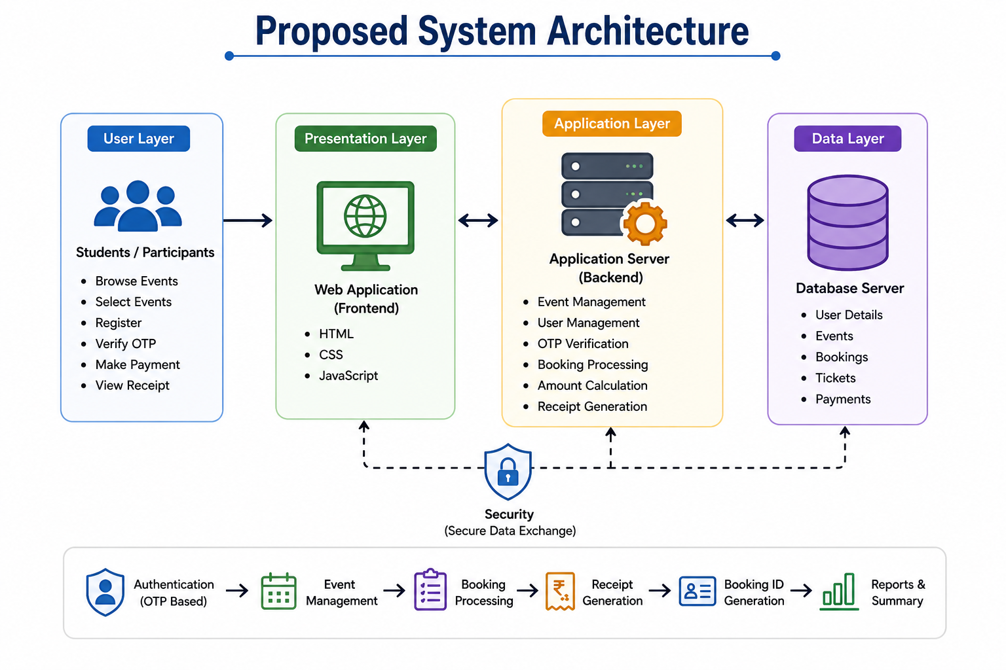
PROPOSED SYSTEM ARCHITECTURE
1
2
3
4
Input :
Users (students, participants, event organizers) interact with the system through the React-based UI:
Enter personal details (name, email) ,Select event, date, time, and location ,Choose number of tickets ,Submit booking request
View booking history and download QR-based tickets
Processing :
Server-side logic (or client-side logic in your current version) handles:
Input validation (email, ticket count, required fields) ,Ticket availability check, Booking creation and updates, QR code generation for each booking ,Session handling / local storage management ,API request & response handling (if backend is used).
Database :
The system stores and manages data such as:
User details (name, email) ,Booking records (event, date, time, tickets) ,Event and location details ,Ticket availability count
(Current system: uses localStorage instead of a real database)
Output :
The system provides results back to users via UI:
Booking confirmation message ,Generated QR code for ticket validation ,Updated ticket availability count ,Booking history list
Option to delete or manage bookings
5
6
7
8
9

Slide 7
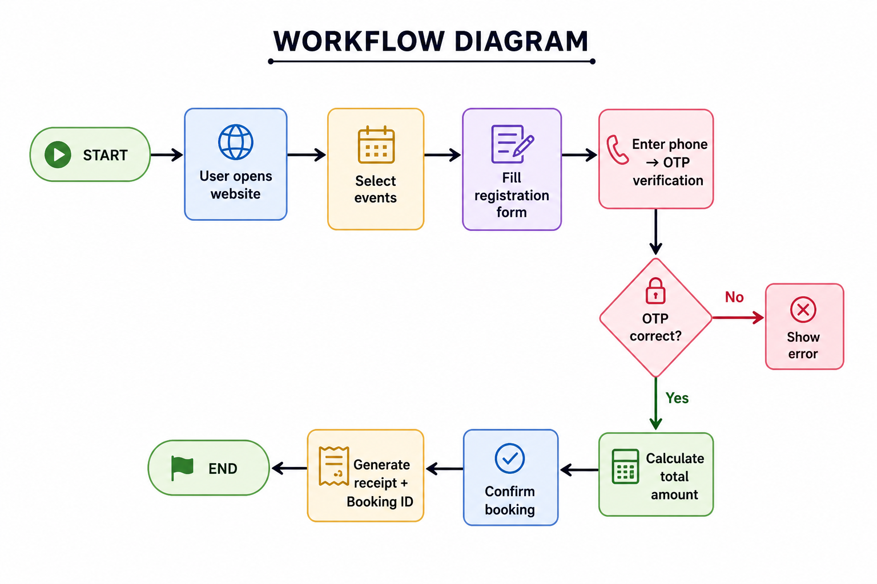
WORKFLOW
1
2
3
4
5
6
7
8
9

Slide 8
TECHNOLOGIES USED
Frontend
Built using HTML, CSS, and JavaScript for user interface.
Provides pages like login, registration, events, and booking.
Backend
Handles logic like authentication, booking, and event management.
In this project, JavaScript (client-side) acts as backend logic.
Database
Stores user data, event details, and booking records.
Uses localStorage (can be replaced with MySQL/MongoDB).
Third-Party API
Used for additional features like icons and fonts.
Example: Font Awesome, Google Fonts.
Tools
Code editor like VS Code for development.
Browser (Chrome) for testing and debugging.
Hardware/Software Requirements
Hardware: Computer/Laptop with internet connection.
Software: Web browser, OS (Windows/Linux), and code editor.
1
2
3
4
5
6
7
8
9

Slide 9
MODULE DESCRIPTION
Module 1 — User Input
Collect user details (name, email)
Select event, date, time, location, tickets
Module 2 — Booking Management
Create and store bookings
Manage ticket availability
Update/delete bookings
Module 3 — Validation & Processing
Validate inputs (email, fields)
Check ticket limits
Process booking logic
Module 4 — QR Code Generation
Generate QR code for each booking
Used for ticket verification
Module 5 — Storage Management
Store bookings using localStorage
Maintain ticket count
Display booking history
Delete individual bookings
Clear all bookings
Module 6 — Output & Confirmation
Show booking confirmation
Display QR code and details
Update available tickets in real-time
1
2
3
4
5
6
7
8
9

Slide 10
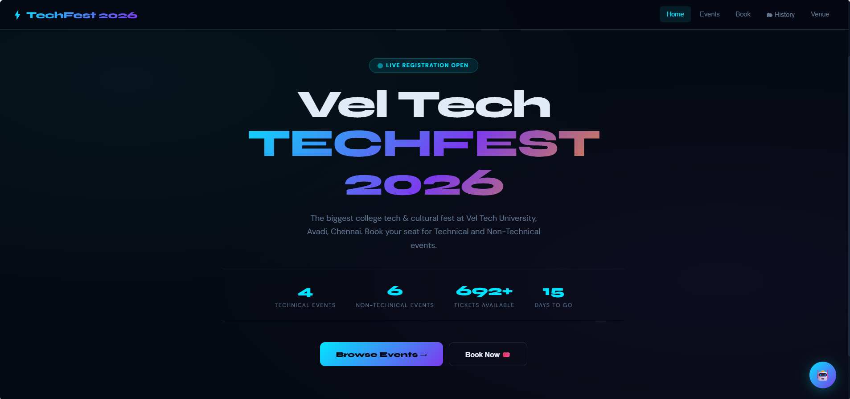
IMPLEMENTATION SCREENSHOTS
.
1
2
3
4
5
6
7
8
9
Homepage – TechFest 2026
Displays event title and highlights registration status.
Shows key details like events count and tickets available.
Provides options to browse events and book tickets.

Slide 11
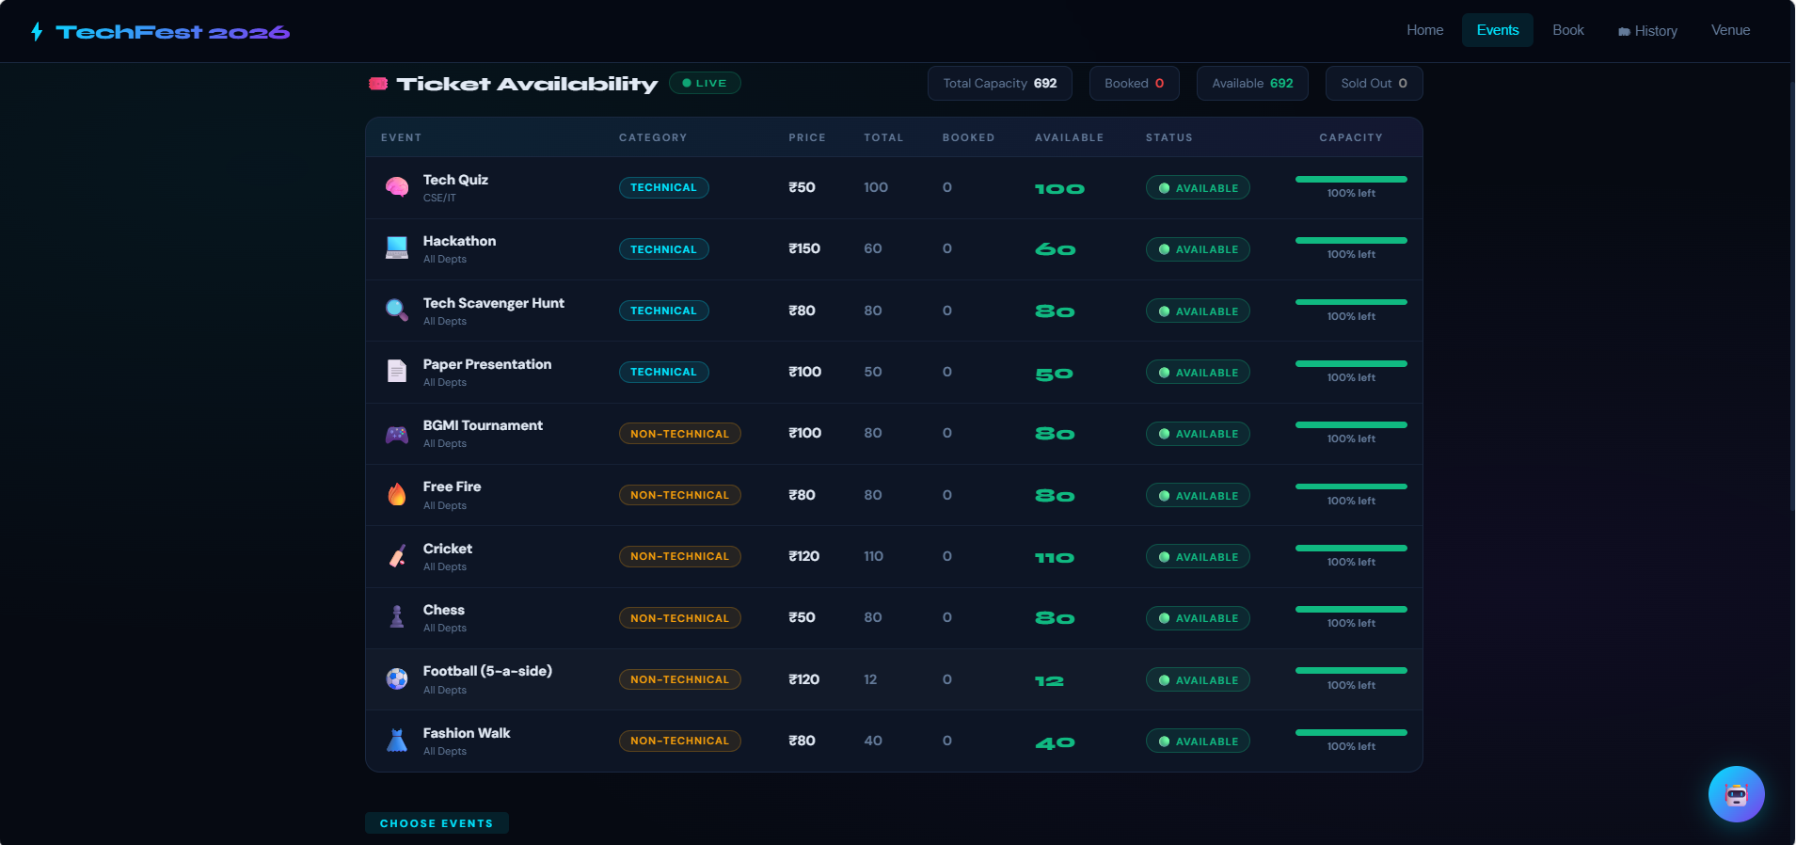
IMPLEMENTATION SCREENSHOTS
1
2
3
4
5
6
7
8(A)
9

Slide 12
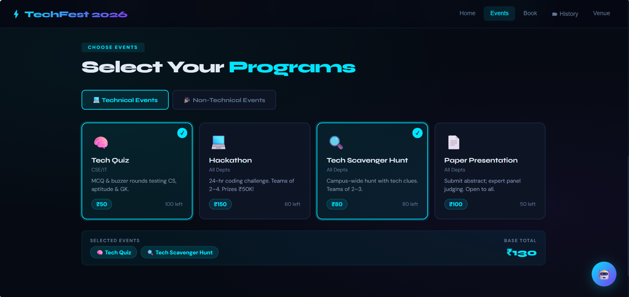
IMPLEMENTATION SCREENSHOTS
1
2
3
4
5
6
7
8(B)
9
Technical Events Selection
Displays available technical and non-technical events with details and pricing.
Allows users to select events and view remaining slots.
Shows selected events with total cost calculation.

Slide 13
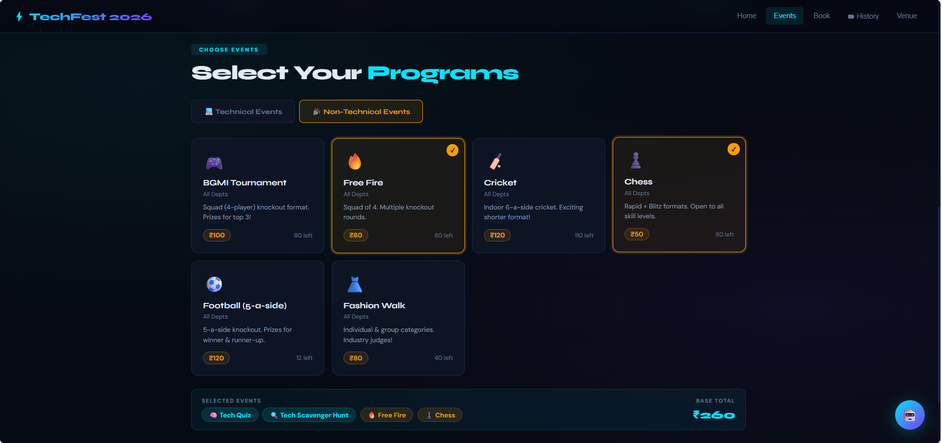
IMPLEMENTATION SCREENSHOTS
1
2
3
4
5
6
7
8(C)
9
Non-Technical Events Selection
Displays non-technical events like games and activities with details and pricing.
Allows users to select events and view available slots.
Updates selected events list with total cost automatically.

Slide 14
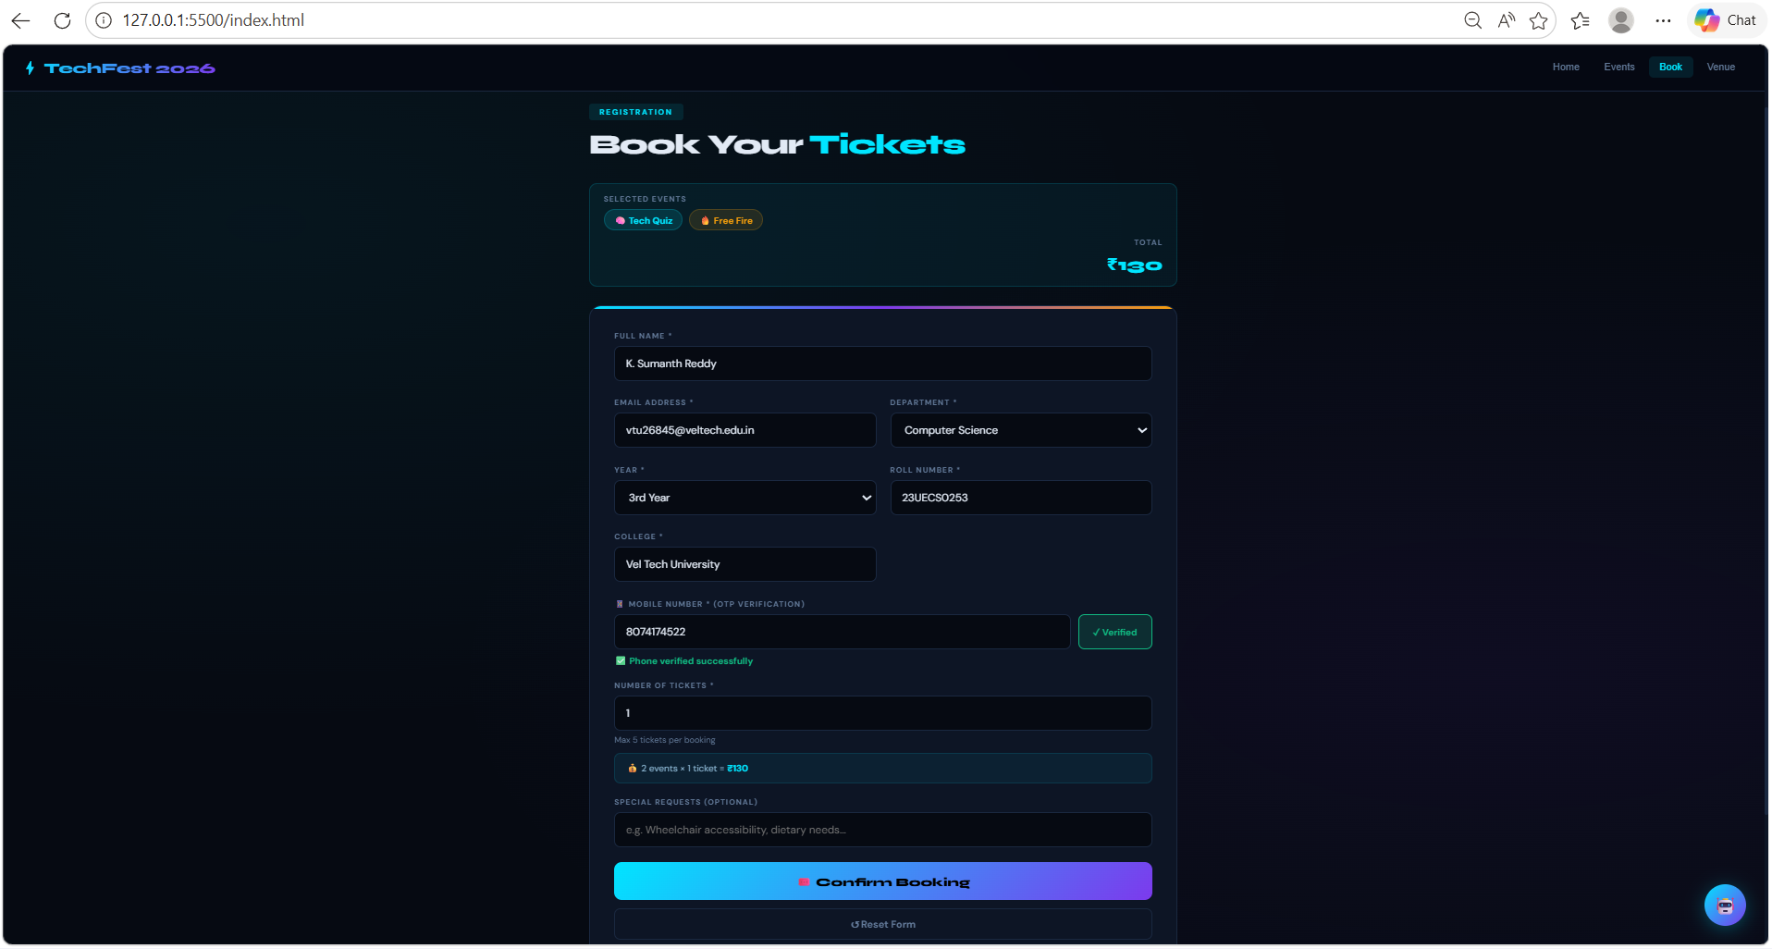
IMPLEMENTATION SCREENSHOTS
1
2
3
4
5
6
7
8(D)
9
Ticket Booking – User Details Form
Collects user information like name, email, department, and college.
Includes OTP verification for mobile number and ticket selection.
Displays selected events with total amount and confirms booking.

Slide 15
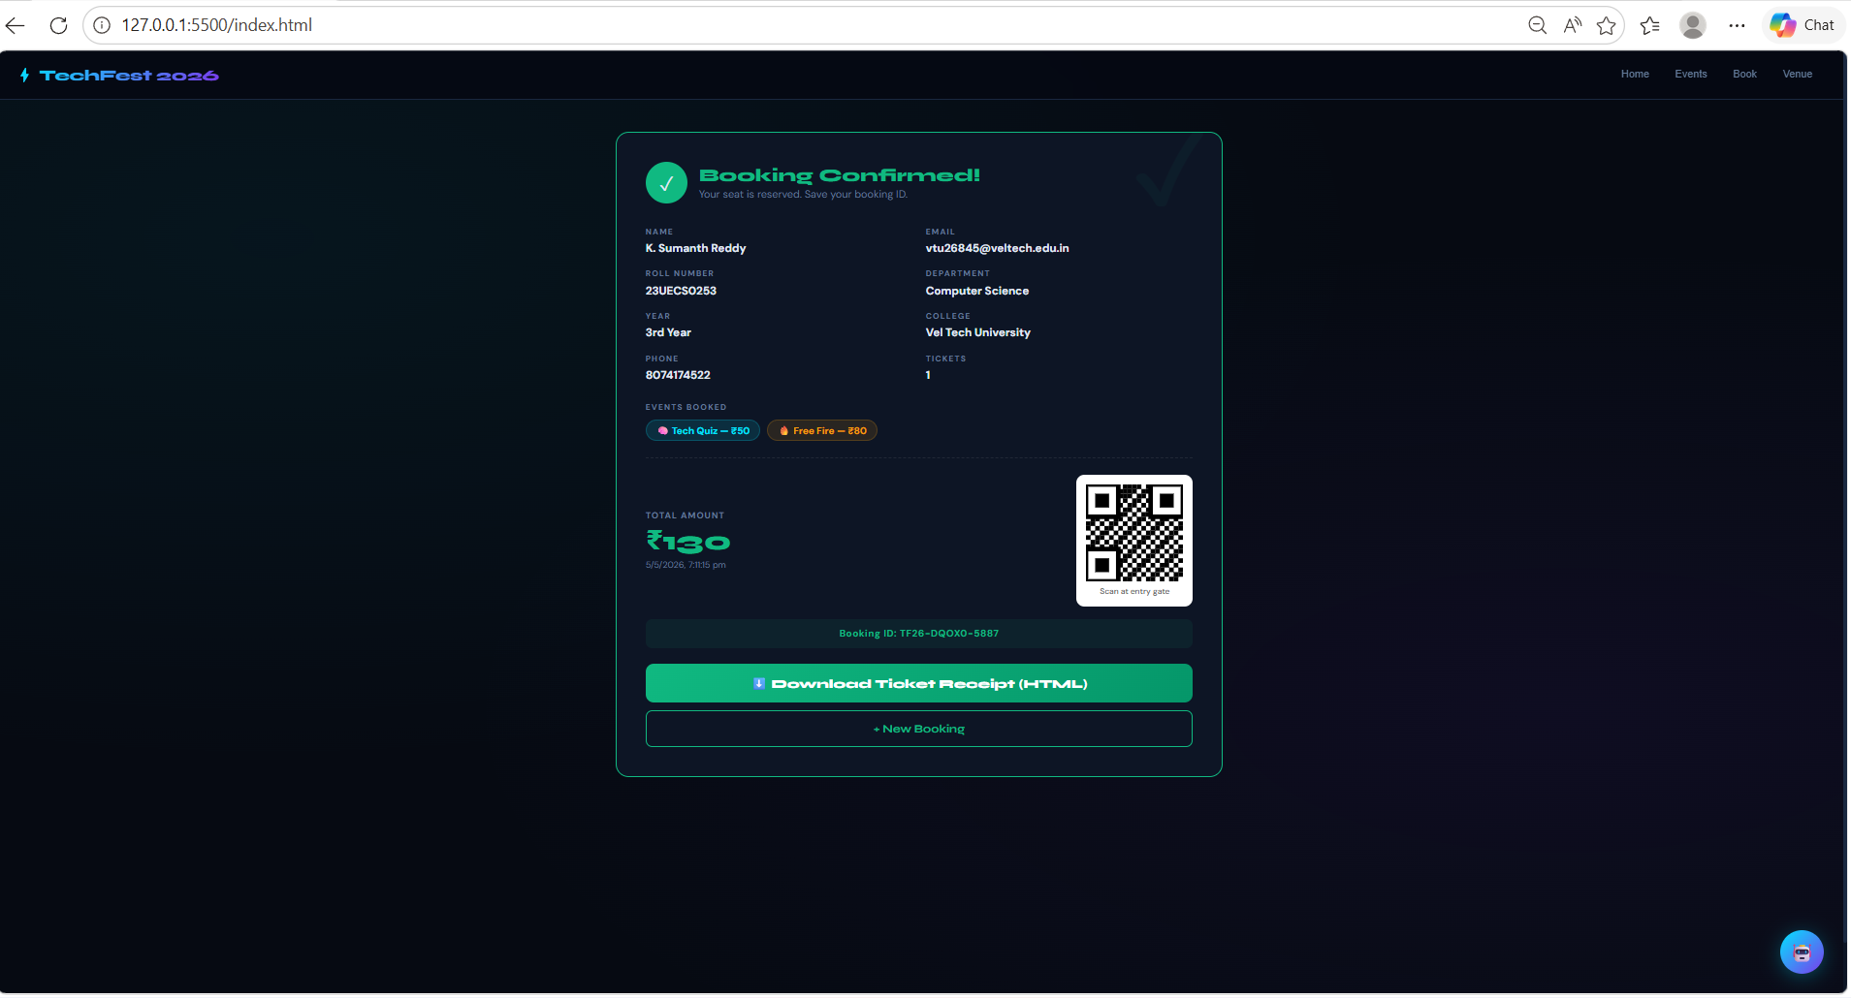
IMPLEMENTATION SCREENSHOTS
1
2
3
4
5
6
7
8(E)
9
Booking - Confirmation Page
Shows booking details and user information.
Displays total amount and selected events.
Provides QR code and download ticket option.

Slide 16
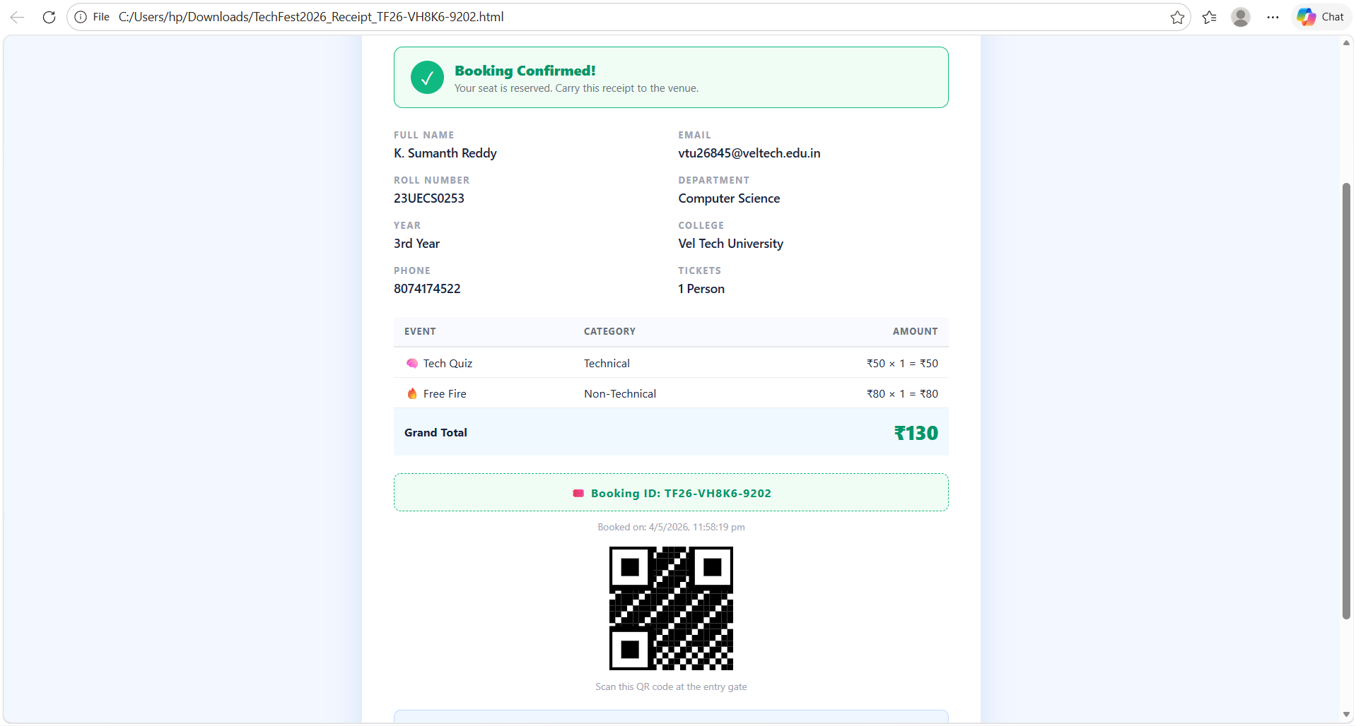
IMPLEMENTATION SCREENSHOTS
1
2
3
4
5
6
7
8(F)
9
Ticket Receipt Page
Shows complete booking details in a clean format.
Displays event list with category and price.
Includes QR code and booking ID for entry verification.

Slide 17
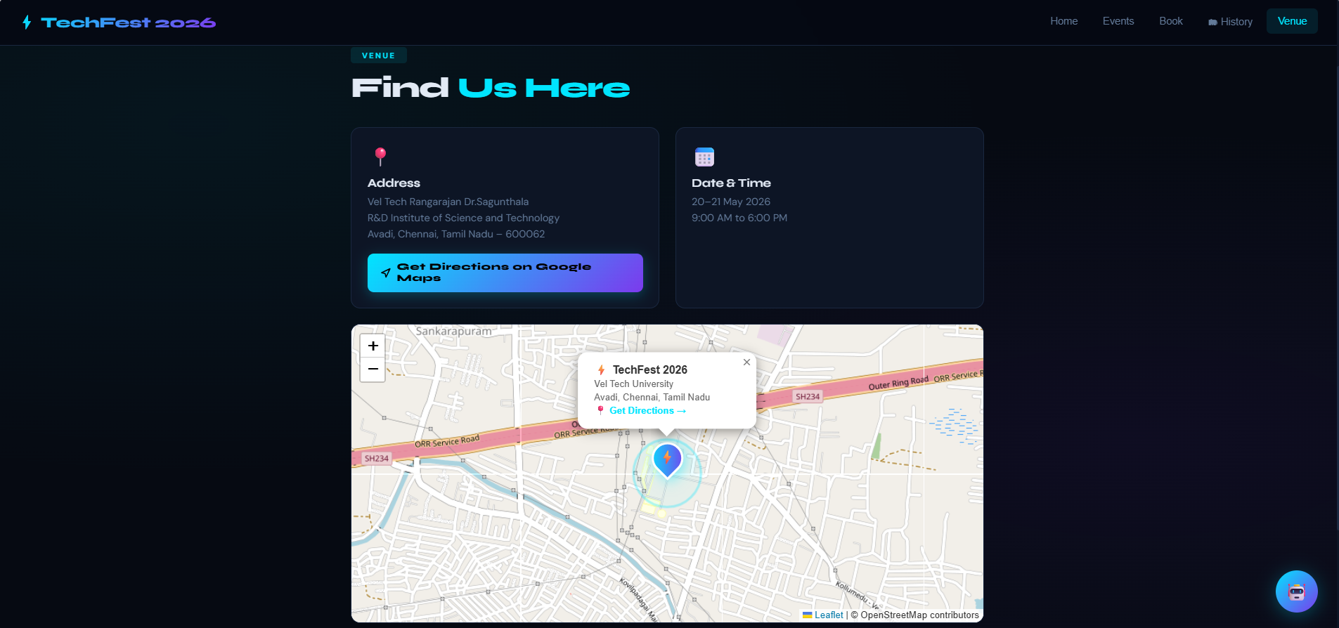
IMPLEMENTATION SCREENSHOTS
1
2
3
4
5
6
7
8(G)
9
Venue & Location Page
Shows event address and date with time.
Provides Google Maps directions button.
Displays map for easy location navigation.

Slide 18
ADVANTAGES & LIMITATIONS
1
Advantages :
Easy Booking Process: Simple interface for quick ticket booking
Real-Time Availability: Instantly updates available ticket count
QR Code Tickets: Secure and easy verification
Lightweight System: Runs directly in browser (no installation)
Instant Feedback: Shows confirmation and booking history immediately
Low Setup Cost: No server/database required (uses localStorage)
2. Limitations :
No Backend Integration: Data stored only in browser (not shared across devices)
Limited Scalability: Not suitable for large-scale or multi-user systems
Basic Security: No authentication or advanced protection
No Real-Time Sync: Multiple users cannot book simultaneously
Data Loss Risk: Clearing browser storage removes all bookings
UI Enhancements Needed: Can be improved for better design and responsiveness
2
3
4
5
6
7
8
9

Slide 19
Thank you

